Slide 1
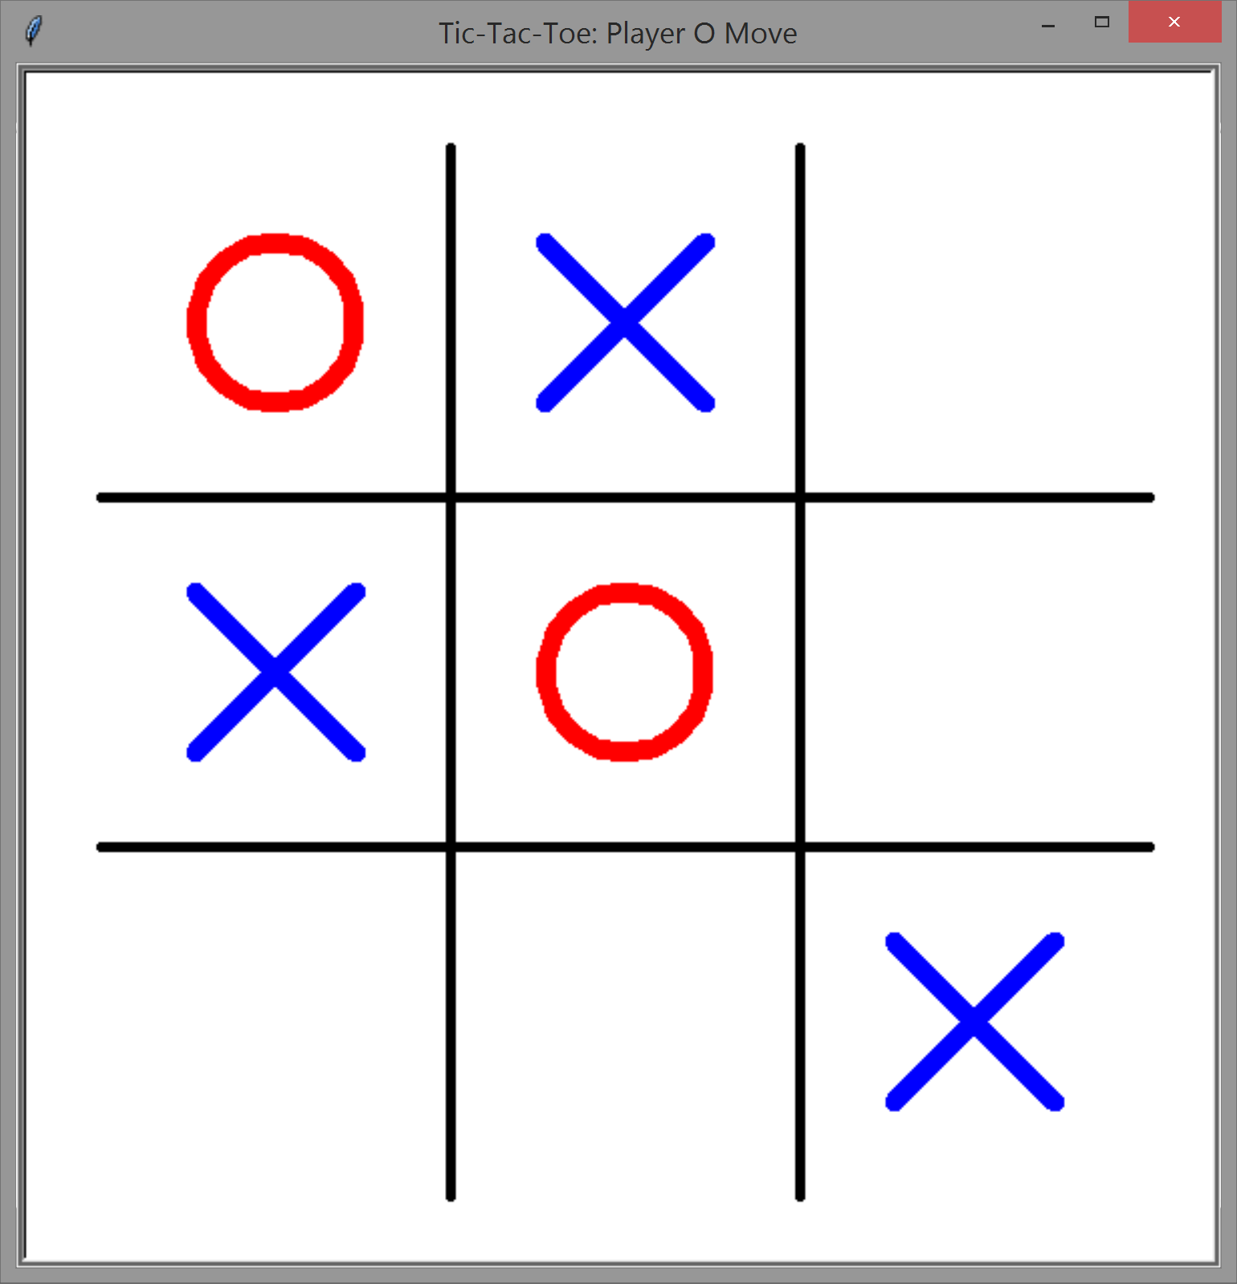
TIC, TAC, TOE
SIMPLE, EASY, FUN
Coders involved: Thomas gray & Brandon Fernandez
Resources & attributions:
https://www.youtube.com/watch?v=lmYVUz3BGyI
https://www.youtube.com/watch?v=RuYg_D_ppYk
https://github.com/mevdschee/python-tictactoe

